Slide 1
Conditional Probability
slides are based on lecture notes on Probability Theory by Phanuel Mariano

Slide 2
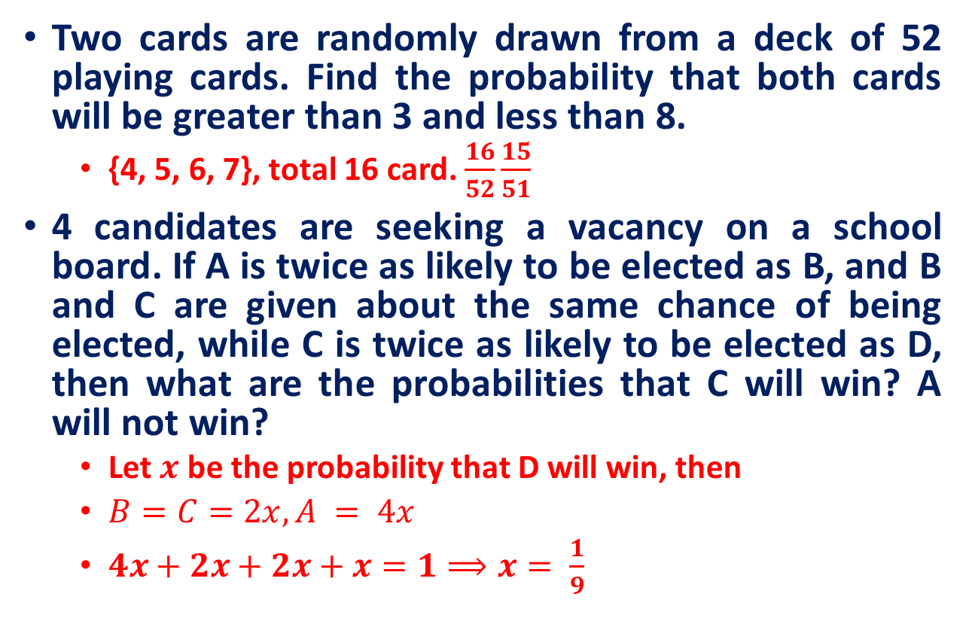
Practice Exercises

Slide 3
Recall
Sample Space
The set of all possible outcomes for an experiment is the sample space.
Tossing a coin: {H, T}
Tossing two coin: {HH,HT, TH, TT}
Event
Consists of one or more outcomes and is a subset of the sample space.
A die is tossed. Event A is observing an even number.
A = {2, 4, 6}
An event that consists of a single outcome is called simple event

Slide 4
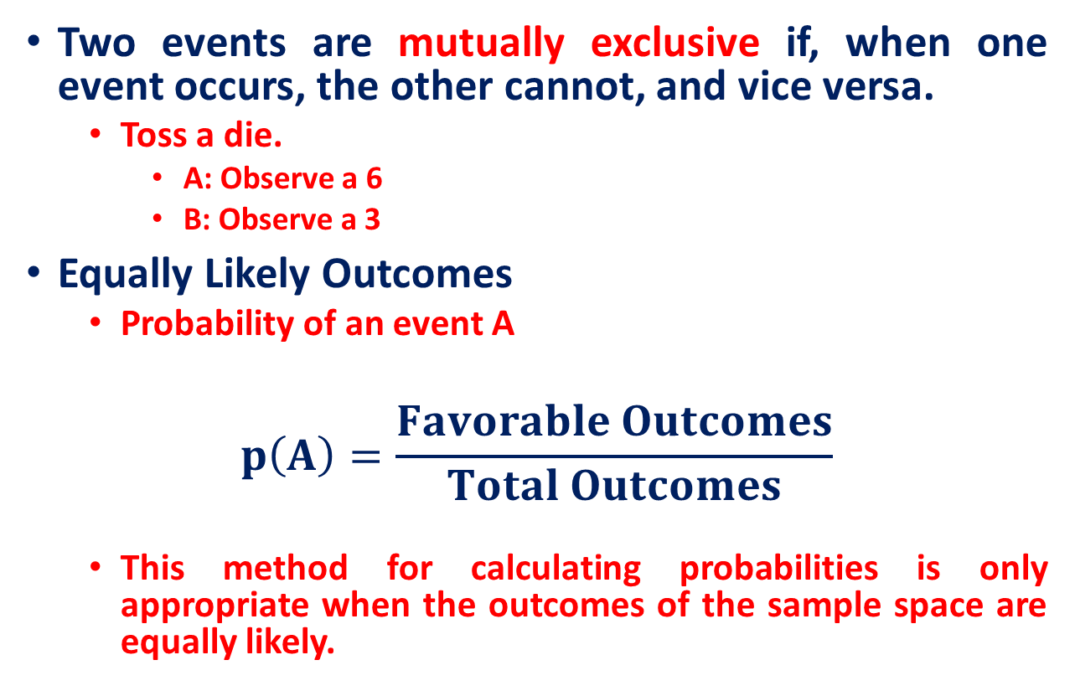
Recall

Slide 5
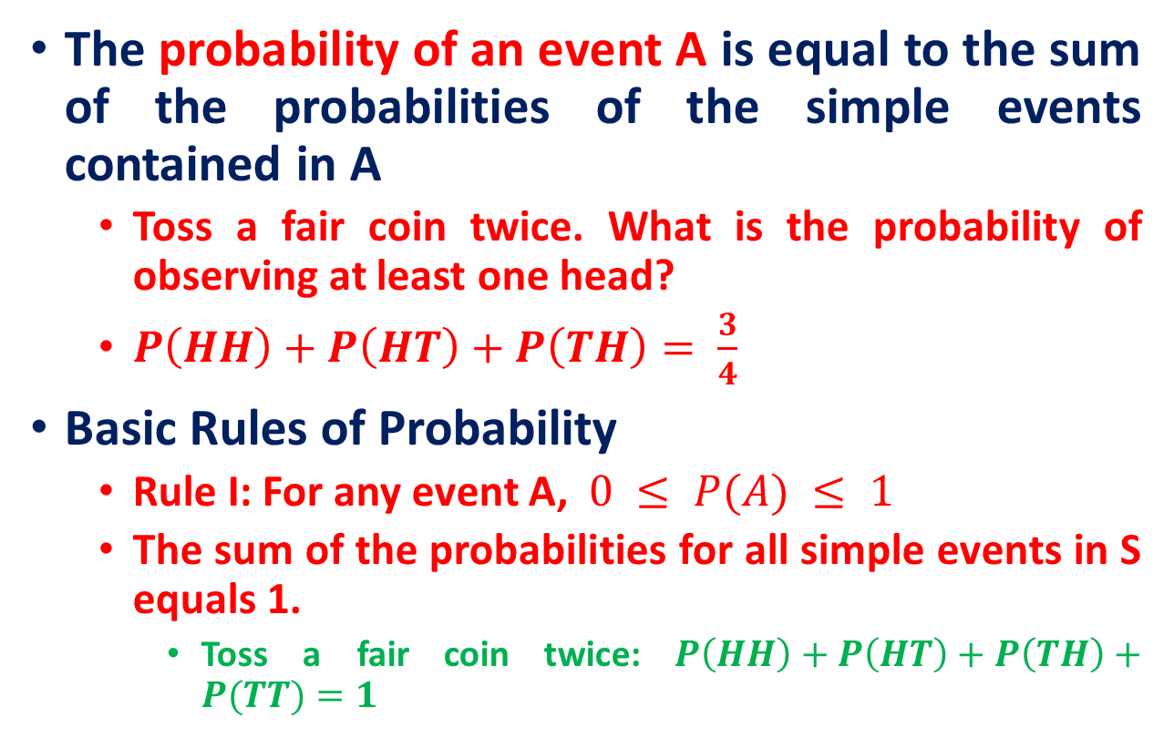
Recall

Slide 6
Recall
Counting Principle
Sample space of throwing 3 dice has 216 entries, sample space of throwing 4 dice has 1296 entries, …
We need a way to help us count faster rather than counting by hand one by one.
(Basic Counting Principle) Suppose 2 experiments are to be performed.
If one experiment can result in m possibilities
Second experiment can result in n possibilities
Then together there are mn possibilities

Slide 7
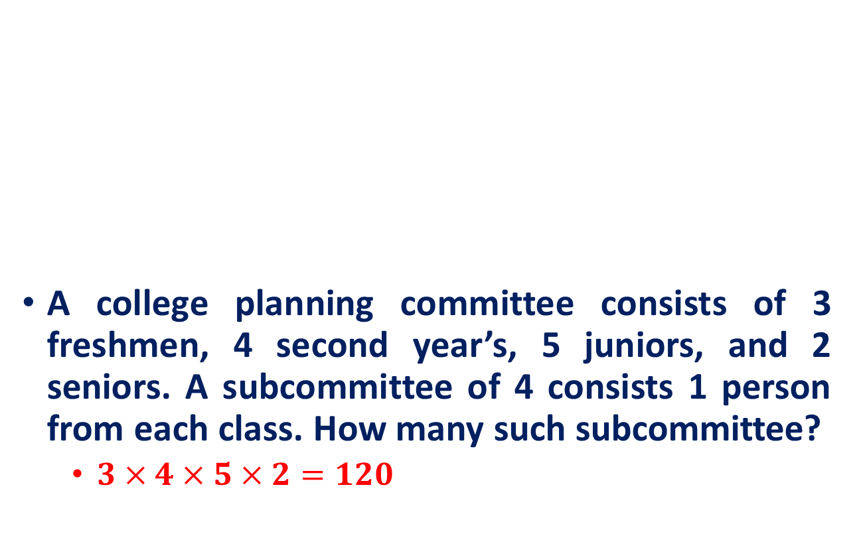
Recall
(Basic Counting Principle) Suppose 2 experiments are to be performed.
If one experiment can result in m possibilities
Second experiment can result in n possibilities
Then together there are mn possibilities

Slide 8
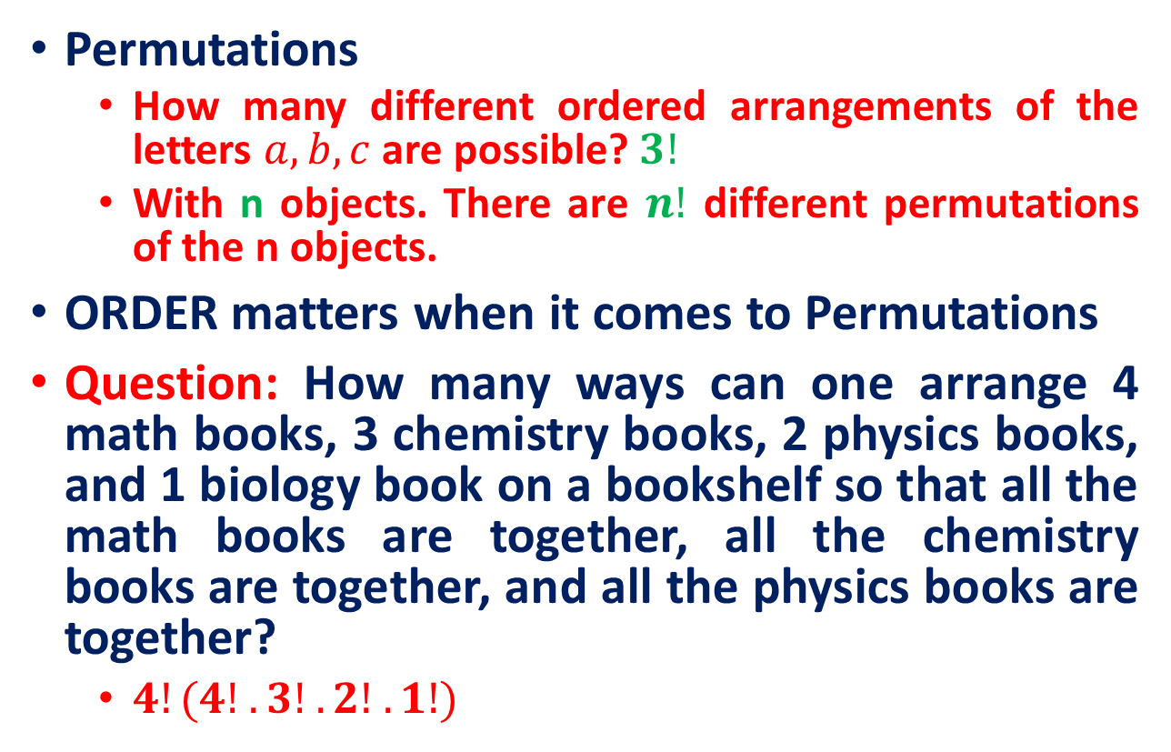
Recall

Slide 9
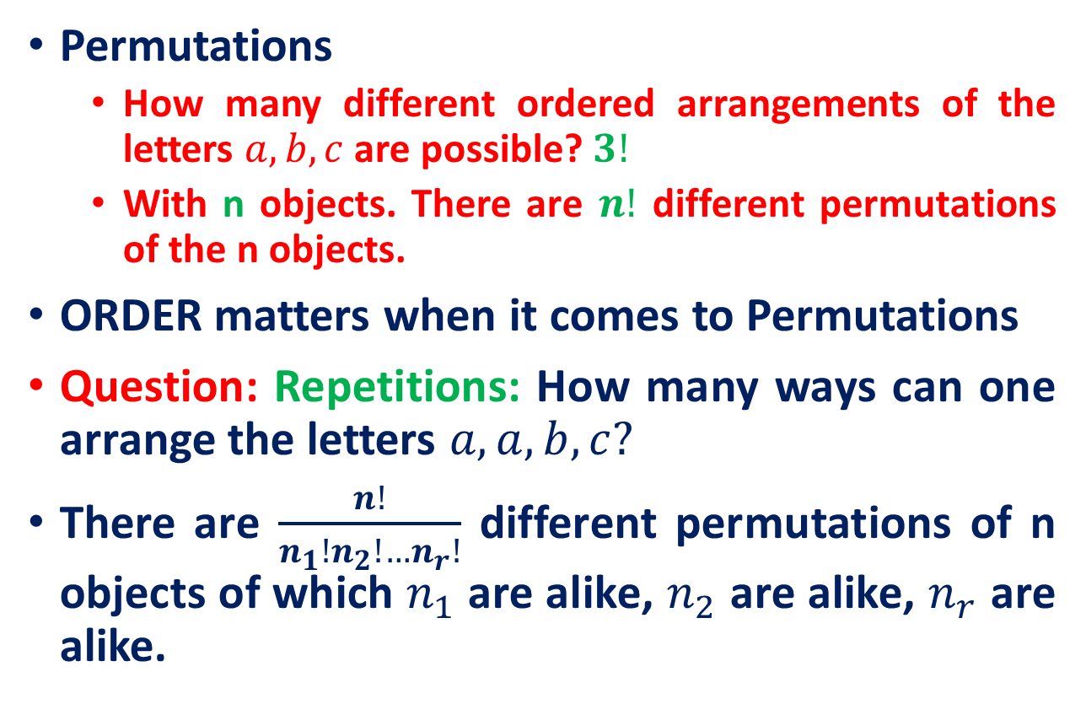
Recall

Slide 10
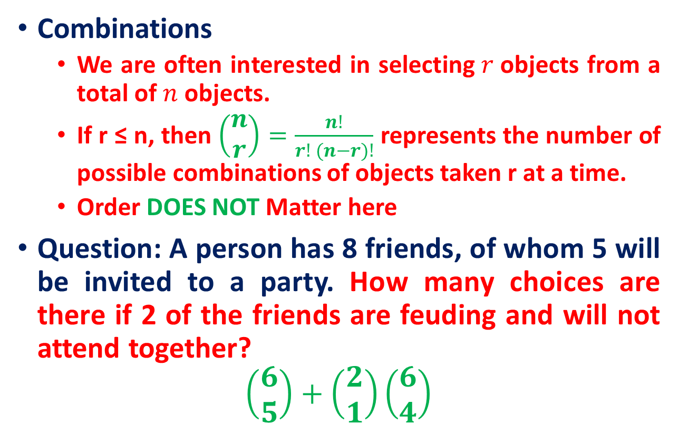
Recall

Slide 11
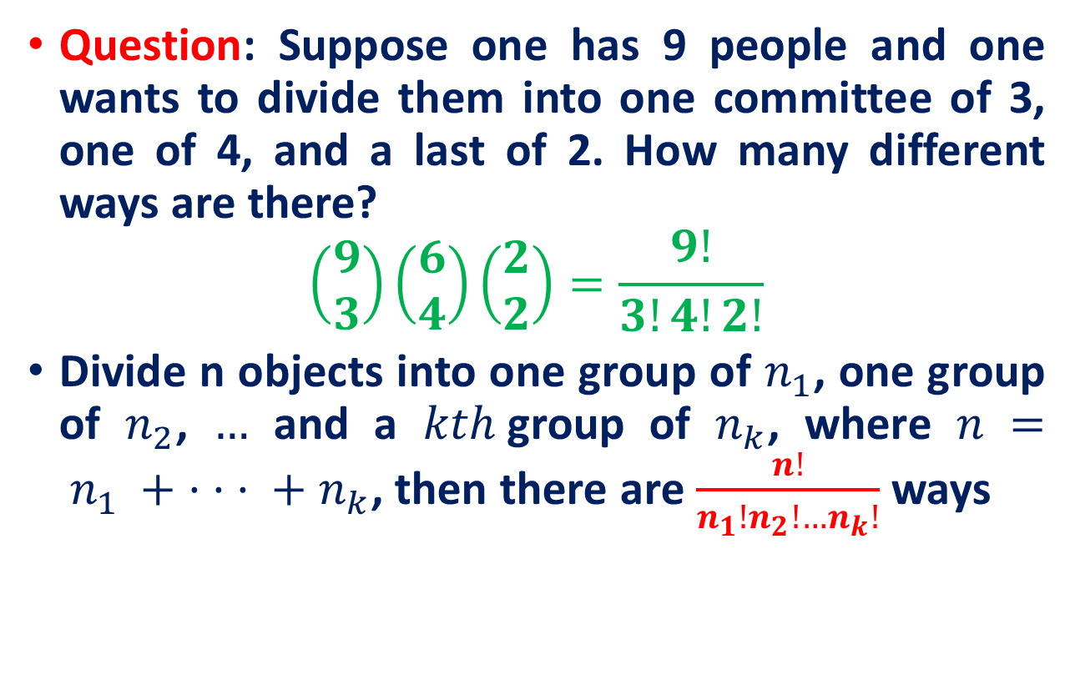
Recall

Slide 12
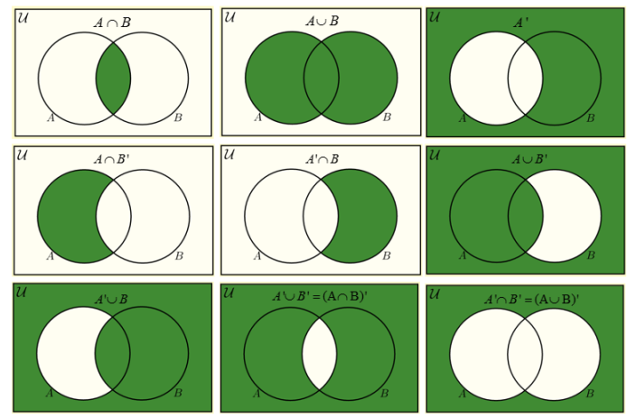
Recall

Slide 13
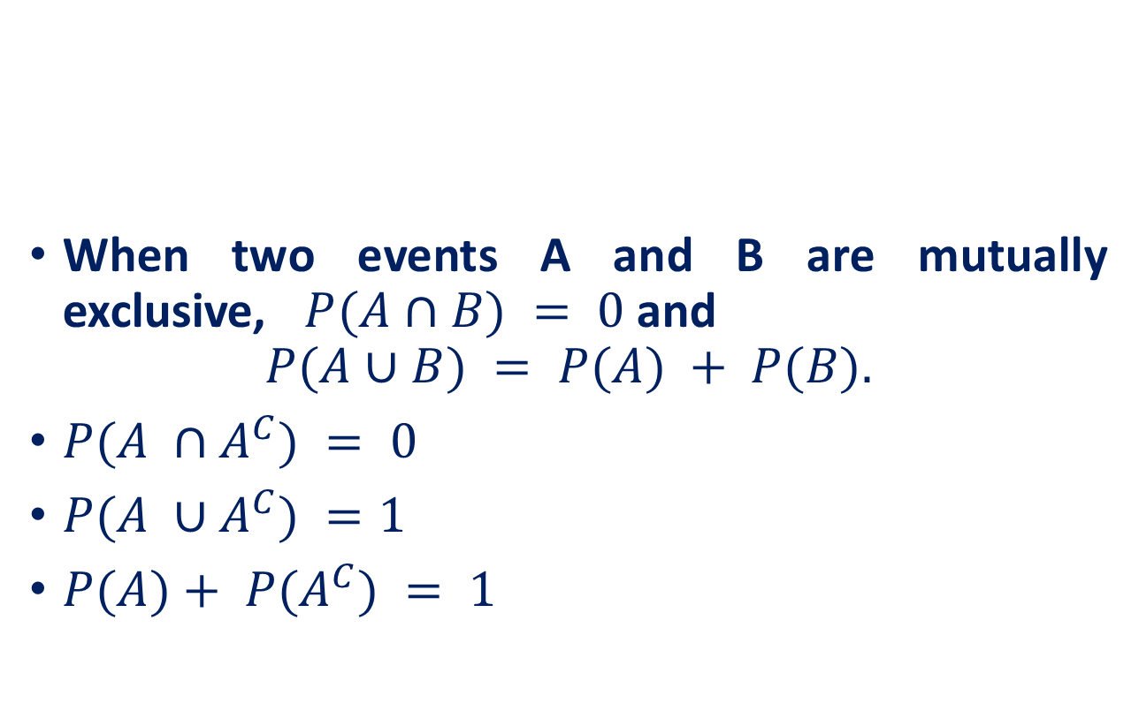
Recall
A
B
A^{C}
A

Slide 14
Will You Play?
Suppose that a “friend” offers you to play a game. He has three cards, one red on both sides, one black on both sides, and one red on one side and black on the other.
He mixes the three cards in a hat, picks one at random, and places it flat on the table with only one side showing.
Suppose that one side is red. He then offers to bet his $4 against your $3 that the other side of the card is also red.

Slide 15
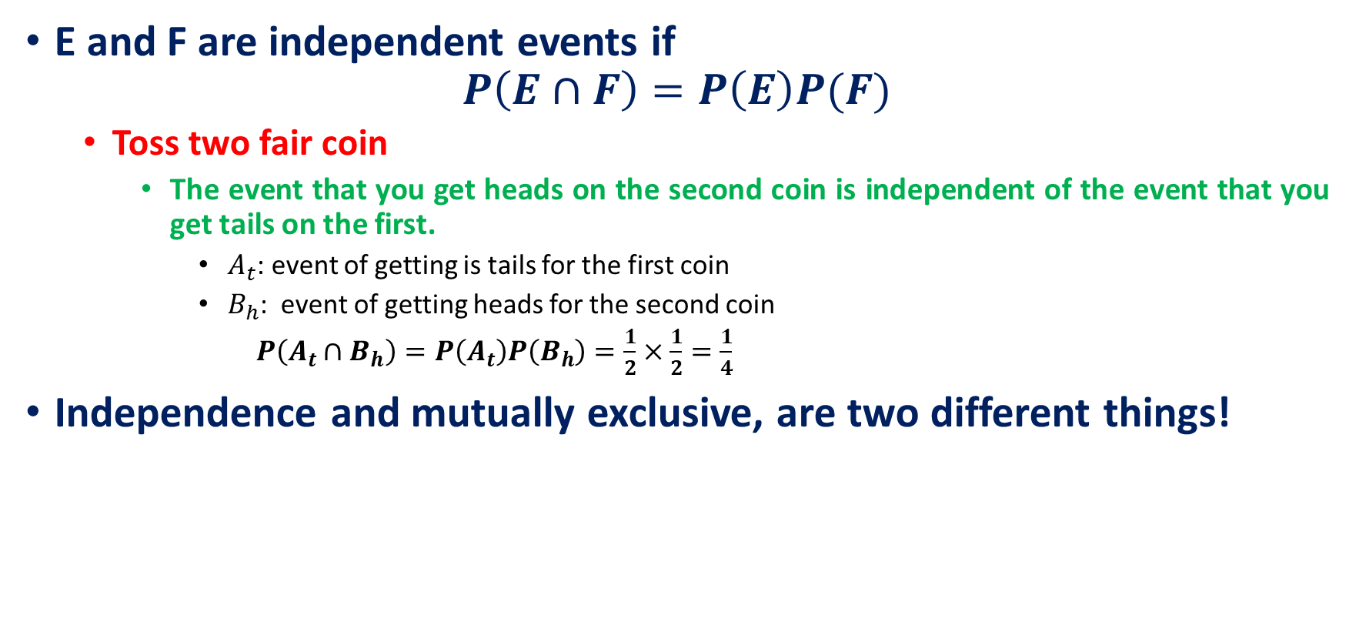
Independent Events
The occurrence of one event will result in the non-occurrence of the other in mutually exclusive events.
Ex. Outcomes of rolling a die are mutually exclusive events. You can get either 5 or 6, but you can never get 5 and 6 at the same time.
In independent events, the occurrence of one event has no bearing on the occurrence of the other.
Ex. Outcomes of rolling a die two times are independent events.

Slide 16
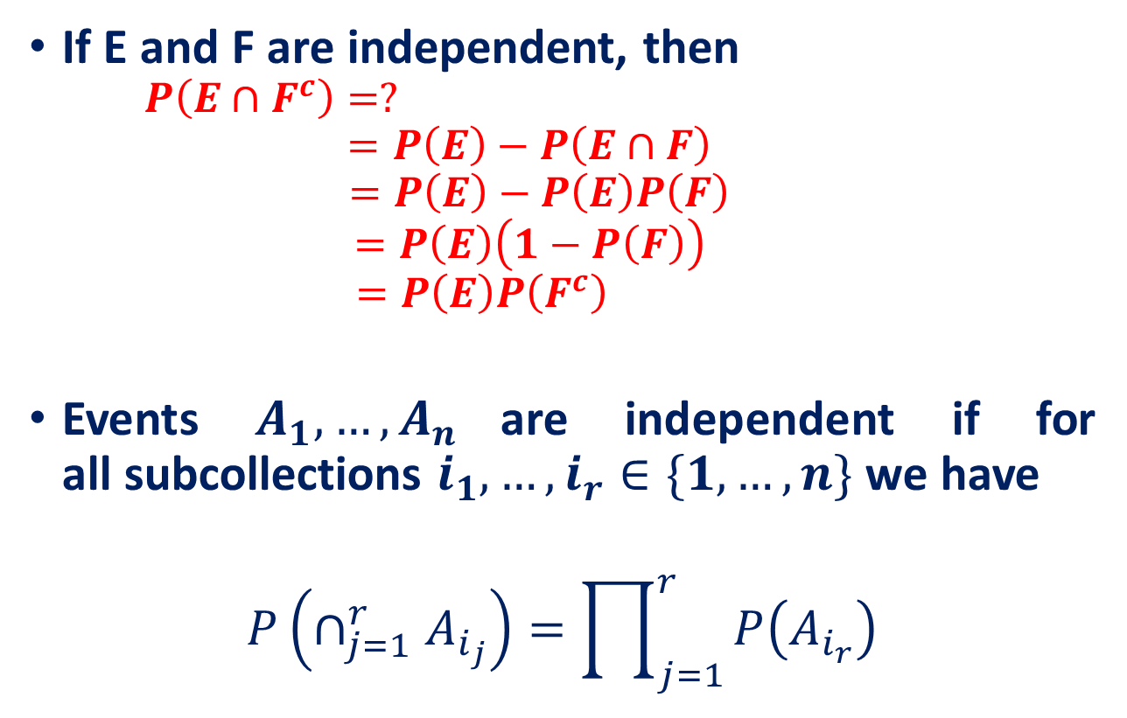
Independent Events

Slide 17
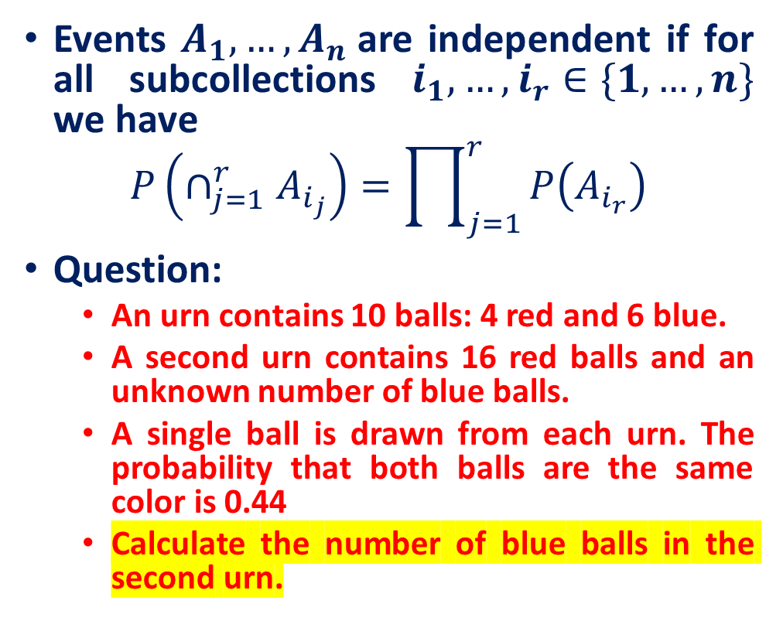
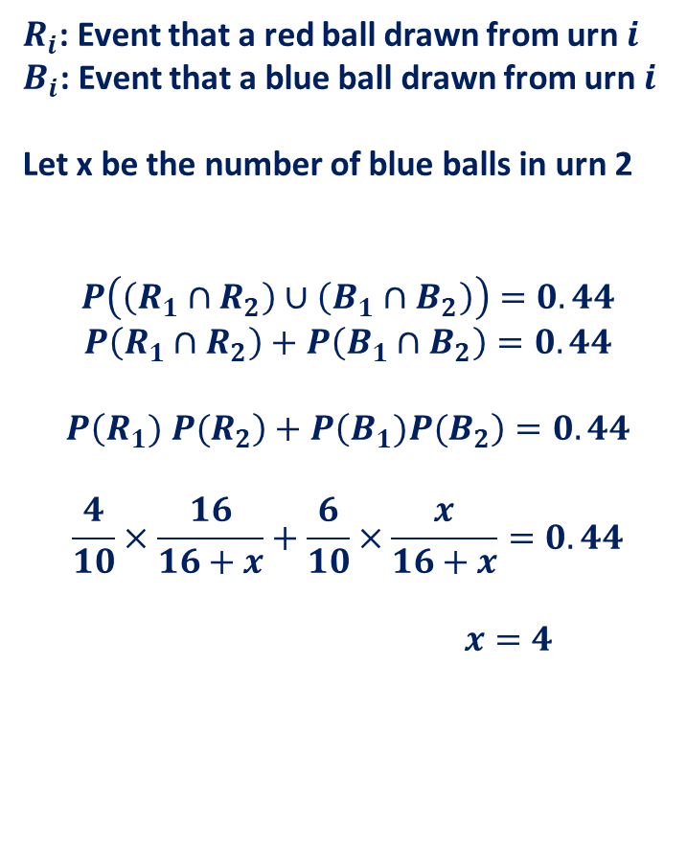
Independent Events

Slide 18
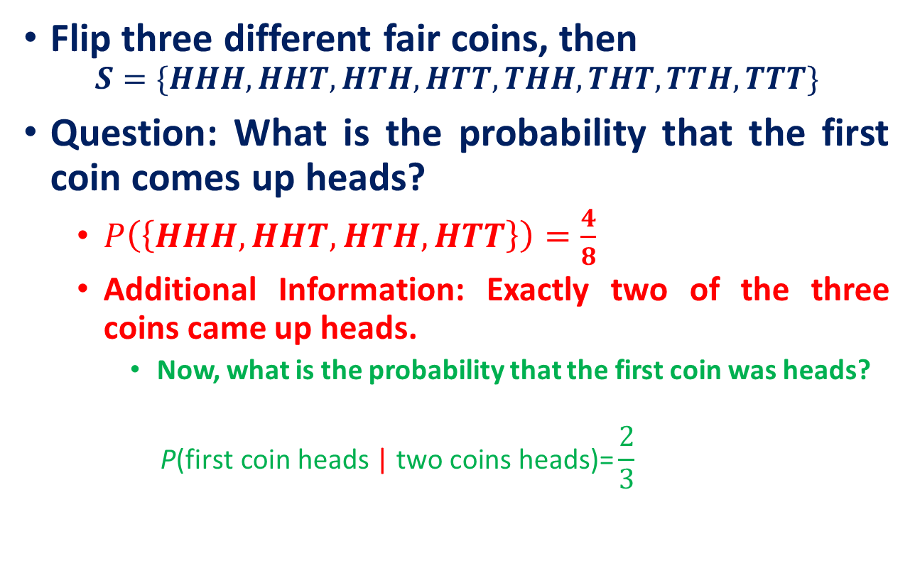
Conditional Probability and Independence
“conditional on,” or “given that
More precisely, we have computed a conditional probability. That is, we have determined that, conditional on knowing that exactly two coins came up heads, the conditional probability of the first coin being head is 2/3.

Slide 19
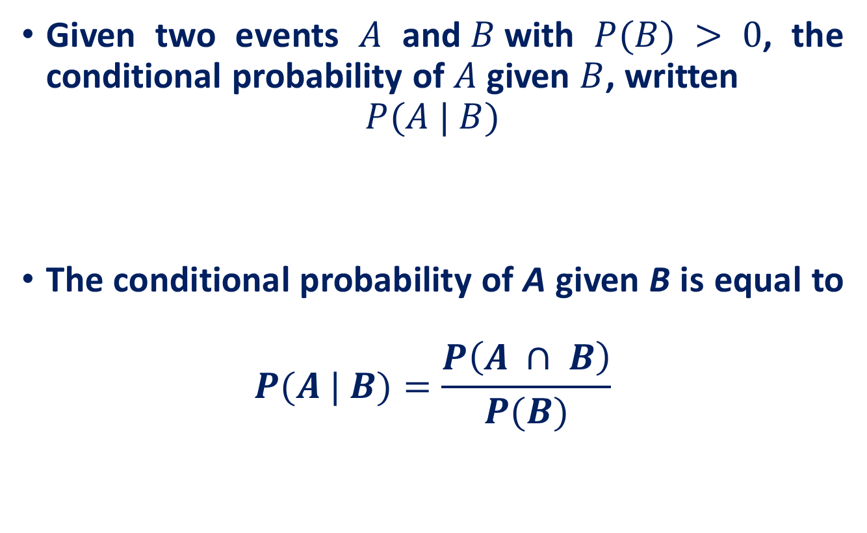
Conditional Probability
Fraction of the time that A occurs once we know that B occurs.

Slide 20
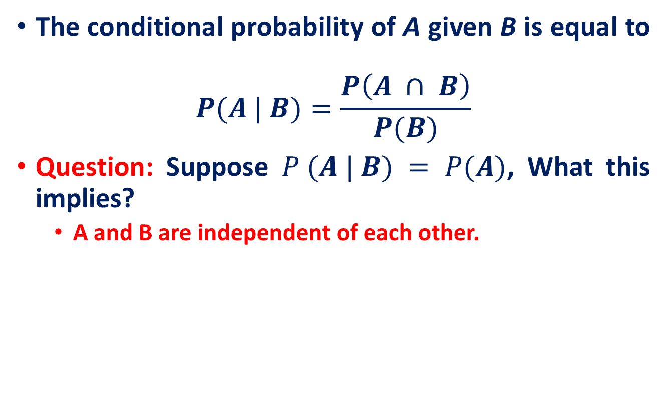
Conditional Probability

Slide 21
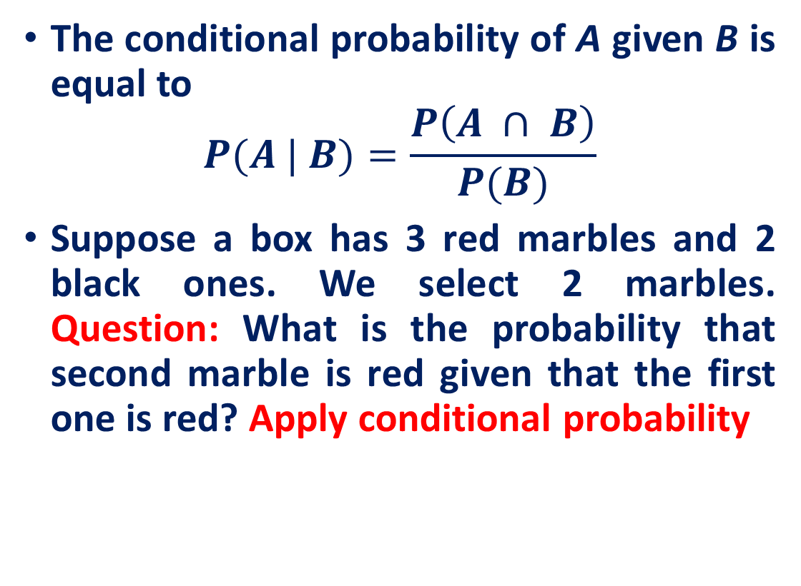
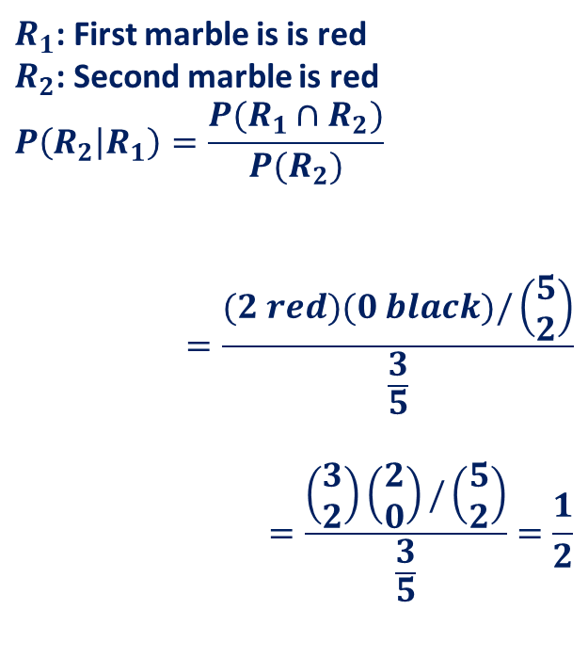
Conditional Probability

Slide 22
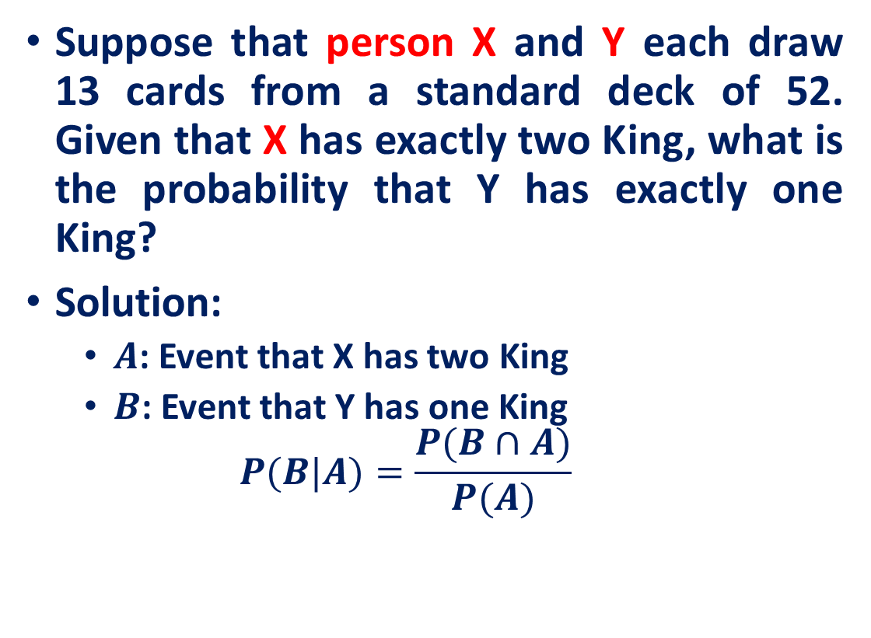
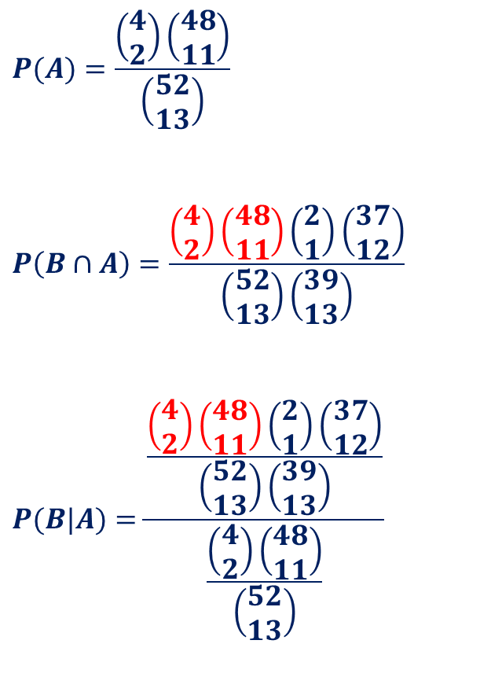
Conditional Probability

Slide 23
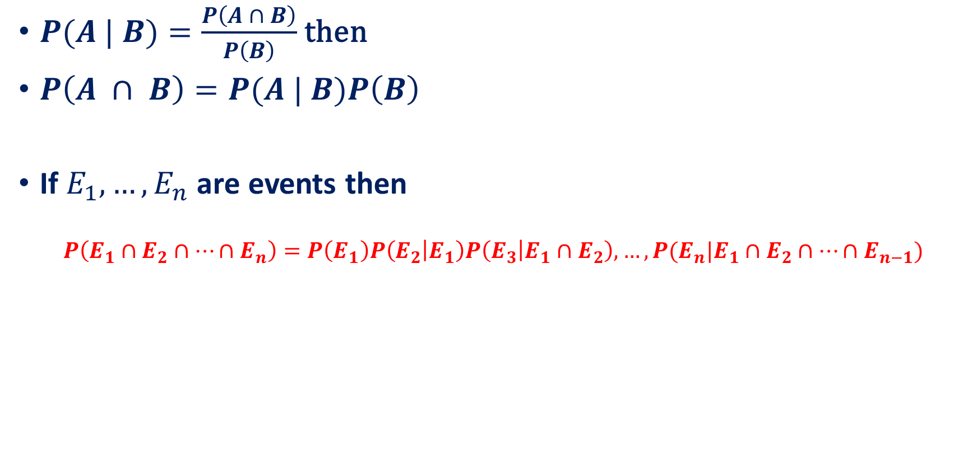
Conditional Probability

Slide 24
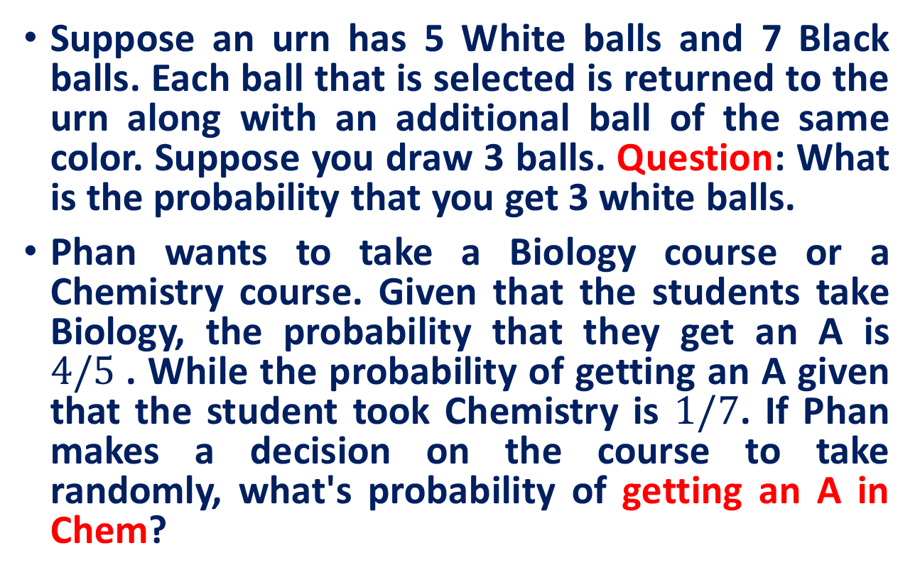
Practice Exercises

Slide 25
Today’s Class
Bayes' Formula

Slide 26
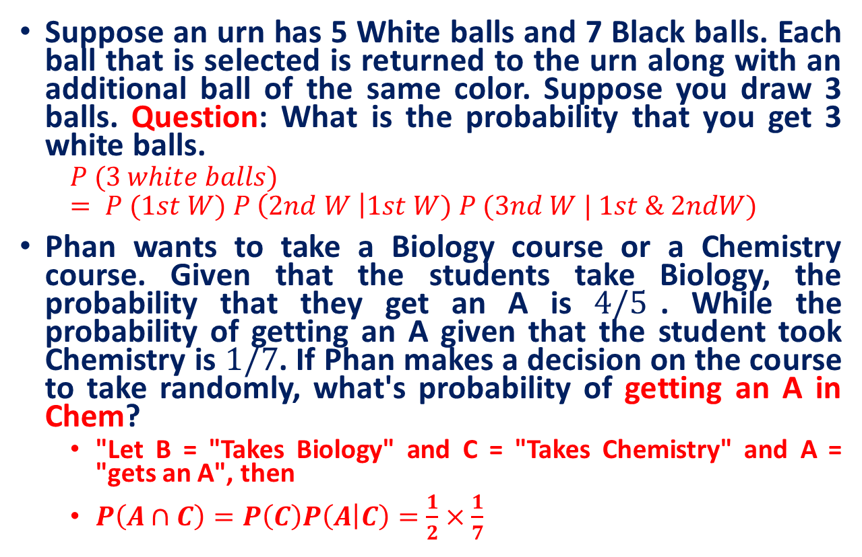
Practice Exercises

Slide 27
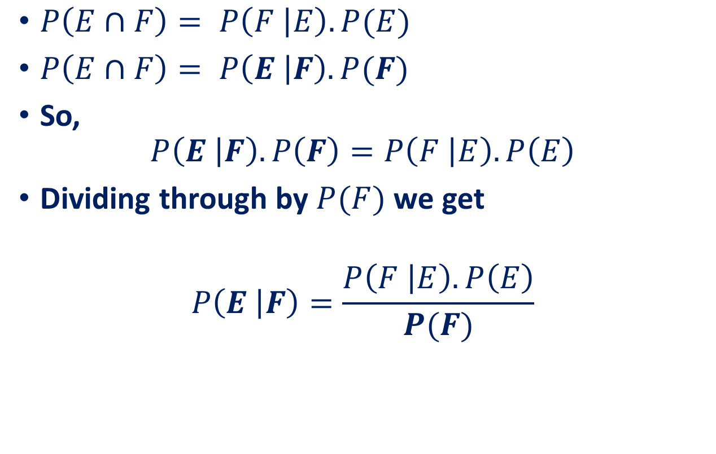
Bayes' Formula
Bayes’ law
This law is important in the cases where we want to know the number on the left, and we do know (or can guess) the numbers on the right.

Slide 28
Reference
Statistics with Economics and Business Applications, Chapter 3 Probability and Discrete Probability Distributions
Modern Business Statistics, Slides by John Loucks
lecture notes on Probability Theory by Phanuel Mariano

